Slide 1
Statistics for IT
Binomial and Poisson Distributions

Slide 2
Course Objectives
After completing this module, students should be able to
Demonstrate knowledge of statistical terms.
Differentiate between the two branches of statistics.
Identify types of data.
Identify the measurement level for each variable.
Identify the four basic sampling techniques.

Slide 3

Introduction
Discrete random variables take on only a finite or countable number of values.
There are several useful discrete probability distributions. We will learn Binomial and Poisson distributions.

Slide 4
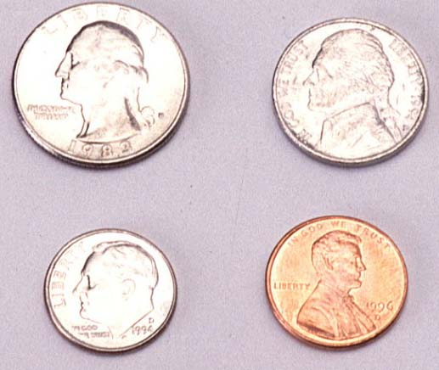
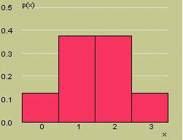
The Binomial Random Variable
The coin-tossing experiment is a simple example of a binomial random variable. Toss a fair coin n = 3 times and record x = number of heads.
x | p(x)
0 | 1/8
1 | 3/8
2 | 3/8
3 | 1/8

Slide 5

The Binomial Random Variable
Many situations in real life resemble the coin toss, but the coin is not necessarily fair, so that P(H) ≠ 1/2.
Example: A geneticist samples 10 people and counts the number who have a gene linked to Alzheimer’s disease.
Coin:
Head:
Tail:
Person
Number of tosses:
P(H):
n = 10
Has gene
P(has gene) = proportion in the population who have the gene.
Doesn’t have gene

Slide 6
The Binomial Experiment
The experiment consists of n identical trials.
Each trial results in one of two outcomes, success (S) or failure (F).
The probability of success on a single trial is p and remains constant from trial to trial. The probability of failure is q = 1 – p.
The trials are independent.
We are interested in x, the number of successes in n trials.

Slide 7
Binomial or Not?
The independence is a key assumption that often violated in real life applications
Select two people from the U.S. population, and suppose that 15% of the population has the Alzheimer’s gene.
For the first person, p = P(gene) = .15
For the second person, p ≈ P(gene) = .15, even though one person has been removed from the population.

Slide 8
Binomial or Not?
2 out of 20 PCs are defective. We randomly select 3 for testing. Is this a binomial experiment?
The experiment consists of n=3 identical trials
Each trial result in one of two outcomes
The probability of success (finding the defective) is 2/20 and remains the same
The trials are not independent. For example,
P( success on the 2nd trial | success on the 1st trial) = 1/19, not 2/20
Rule of thumb: if the sample size n is relatively large to the population size N, say n/N >= .05, the resulting experiment would not be binomial.

Slide 9
The Binomial Probability Distribution
SticiGui
For a binomial experiment with n trials and probability p of success on a given trial, the probability of k successes in n trials is

Slide 10
The Mean and Standard Deviation
For a binomial experiment with n trials and probability p of success on a given trial, the measures of center and spread are:

Slide 11

Example
A marksman hits a target 80% of the
time. He fires five shots at the target. What is the probability that exactly 3 shots hit the target?
n =
5
hit
p =
.8
x =
# of hits
success =

Slide 12
Example
What is the probability that more than 3 shots hit the target?

Slide 13
Cumulative Probability Tables
You can use the cumulative probability tables to find probabilities for selected binomial distributions.
Find the table for the correct value of n.
Find the column for the correct value of p.
The row marked “k” gives the cumulative probability, P(x ≤ k) = P(x = 0) +…+ P(x = k)

Slide 14
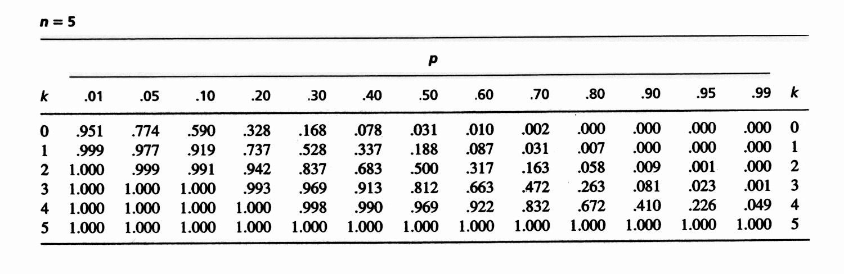
Example
k | p = .80
0 | .000
1 | .007
2 | .058
3 | .263
4 | .672
5 | 1.000
What is the probability that exactly 3 shots hit the target?
P(x = 3) = P(x ≤ 3) – P(x ≤ 2)
= .263 - .058
= .205
Check from formula: P(x = 3) = .2048

Slide 15
Example
k | p = .80
0 | .000
1 | .007
2 | .058
3 | .263
4 | .672
5 | 1.000
What is the probability that more than 3 shots hit the target?
P(x > 3) = 1 - P(x ≤ 3)
= 1 - .263 = .737
Check from formula: P(x > 3) = .7373

Slide 16
Example
Would it be unusual to find that none
of the shots hit the target?
P(x = 0) = P(x ≤ 0) = 0
What is the probability that less than 3 shots hit
the target?
P(x < 3) = P(x ≤ 2) = 0.058
What is the probability that less than 4 but more than 1 shots hit the target?
P(1<x < 4) = P(x ≤ 3) - P(x ≤ 1)
= .263-.007=.256

Slide 17
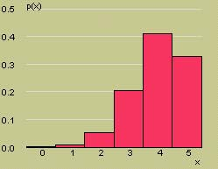
Example
Here is the probability distribution for x = number of hits. What are the mean and standard deviation for x?
μ

Slide 18
The Poisson Random Variable
The Poisson random variable x is often a model for data that represent the number of occurrences of a specified event in a given unit of time or space.
Examples:
The number of calls received by a switchboard during a given period of time.
The number of machine breakdowns in a day
The number of traffic accidents at a given intersection during a given time period.

Slide 19
The Poisson Probability Distribution
Let x a Poisson random variable. The probability of k occurrences of this event is
For values of k = 0, 1, 2, … The mean and standard deviation of the Poisson random variable are
Mean: μ
Standard deviation:

Slide 20

Example
The average number of traffic accidents on a certain section of highway is two per week. Find the probability of exactly one accident during a one-week period.

Slide 21
Cumulative Probability Tables
You can use the cumulative probability tables to find probabilities for selected Poisson distributions.
Find the column for the correct value of μ.
The row marked “k” gives the cumulative probability, P(x ≤ k) = P(x = 0) +…+ P(x = k)

Slide 22
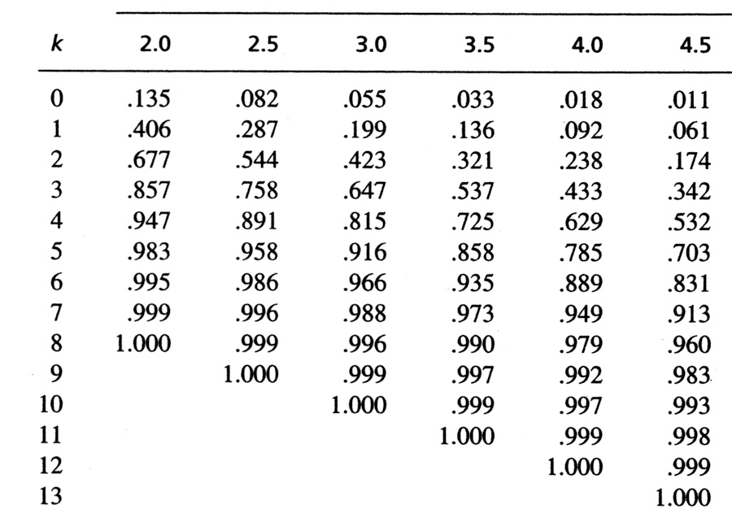
Example
What is the probability that there is exactly 1 accident?
k | μ = 2
0 | .135
1 | .406
2 | .677
3 | .857
4 | .947
5 | .983
6 | .995
7 | .999
8 | 1.000
P(x = 1) = P(x ≤ 1) – P(x ≤ 0)
= .406 - .135
= .271
Check from formula: P(x = 1) = .2707

Slide 23
Example
k | μ = 2
0 | .135
1 | .406
2 | .677
3 | .857
4 | .947
5 | .983
6 | .995
7 | .999
8 | 1.000
What is the probability that 8 or more accidents happen?
P(x ≥ 8) = 1 - P(x < 8)
= 1 – P(x ≤ 7)
= 1 - .999 = .001

Slide 24
Key Concepts
The Binomial Random Variable
1. Five characteristics: n identical trials, each resulting in either success S or failure F; probability of success is p and remains constant from trial to trial; trials are independent; and x is the number of successes in n trials.
2. Calculating binomial probabilities
a. Formula:
b. Cumulative binomial tables
3. Mean of the binomial random variable: μ = np
4. Variance and standard deviation: σ ² = npq and

Slide 25
Key Concepts
II. The Poisson Random Variable
1. The number of events that occur in a period of time or space, during which an average of μ such events are expected to occur
2. Calculating Poisson probabilities
a. Formula:
b. Cumulative Poisson tables
3. Mean of the Poisson random variable: E(x) = μ
4. Variance and standard deviation: σ ² = μ and

Slide 26
Key Concepts
III. The Hypergeometric Random Variable
1. The number of successes in a sample of size n from a finite population containing M successes and N − M failures
2. Formula for the probability of k successes in n trials:
3. Mean of the hypergeometric random variable:
4. Variance and standard deviation:

Slide 27
Thank You!

